Slide 1



Understanding MPU Usage in Microcontroller-based Systems in the Wild
Wei Zhou, Zhouqi Jiang, Le Guan
Notes:
Hi everyone. I am Wei Zhou from Huazhong University of Science and Technology
It is a great honor to present our work about a specification guided firmware emulation.

Slide 2
Agenda
Introduction to Memory Protection Unit (MPU)
MPU adoption in the wild
Common pitfalls and limitations in using MPU
Mitigation suggestions
Summary and disclosure
Notes:
Ok go back to our presentation
There is the agenda
I will first give some basic background about the MPU and its adoption in the popular embedded Oss
Then We focus on the common pitfalls and limitations in MPU usage
We will also give some mitigation suggestions to these issue and finally summary of our finding

Slide 3
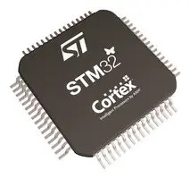
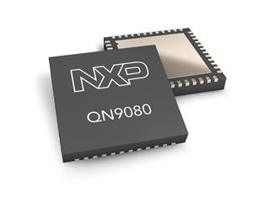
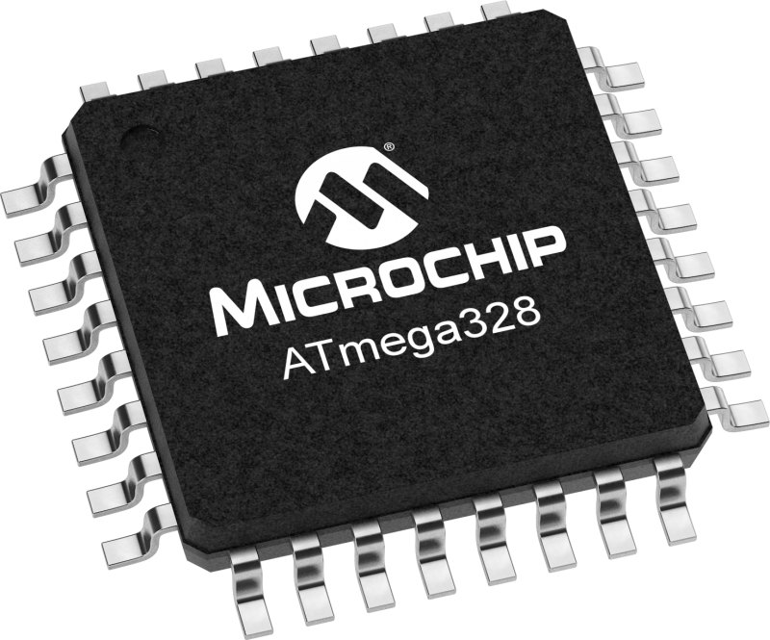
MMU on PC → MPU on MCU
Peri.
Memory
Cache
CPU
MMU
TLB
System bus
The Memory Management Unit (MMU), a standard feature on traditional computing platforms, enforces page-based permission control (R/W/X).
MMU is absent in resource-restricted microcontroller units (MCUs) .
As a stripped-down version of MMU, the Memory Protection Unit (MPU) provides basic security functions for MCUs, e.g., Arm Cortex-M series MCUs.

Slide 4
What is Memory Protection Unit (MPU)
How MPU works?
For a limited number of configurable memory regions, MPU assigns access permissions (R/W/X) based on the current execution privilege level
A fault happens when a memory access violates the access permission
MPU can only be configured by privileged code
MEMORIES
(RAM
ROM)
MPU
Peripheral
CPU
Notes:
So at first what is MPU
I think everyone here is familiar with the MMU which has been widely used in modern operating system for memory protection
However MMU usually absent in the microcontrollers.
As a alternative，ARM, a leading chip designer for many MCU, has proposed the memory protection unit (MPU) as a stripped down version of MMU to protect their system
The function of MPU is simple, MPU can assign different permissions (e.g., R/W) to different Memory regions based on the current privilege level
If the permission is volated a fault handler will be raised and it can only be configured by privileged code

Slide 5
How to Program MPUs (PMSAv7)?
MPU Control Register (MPU_CTRL)
Enable bit: enable the MPU
The PRIVDEFENA bit: enable the default memory map for privileged access
MPU Region Base Address Register (MPU_RBAR)
Set the base address and the identifier of a memory region
MPU Region Attribute/Size Register (RASR)
AP and XN bit: Set permissions (RWX) of a memory region in privileged and unprivileged level
TEX, C and B bits: Set the Attributes (e.g., cacheability and shareability) of a memory region
Size : Set the size of a memory region
Constrains on MPU memory region
(1) At least 32 bytes (2) Power of two
(3) Must be aligned with 32 bytes (4) Limited region numbers (M0+/3/4 up to 8 and M7 up to 16)
Notes:
Let’s see how to use the MPU first
Typically only three regs need to be configured
Ctrl regs is used enable the MPU
And the address registers is used to configure start address and size of each memory region
The attribute/Size Registers is used to configure the access permissions include read write and executable for different permissions and memory attributes
And note that the first one region can be further divided into eight same permission and same size sub-regions and also if enable the background regions
Unmap memory space can only be accessed by privilege access or unmap memory regions cannot be access
==
And MPU also imposes restrictions on the region configurations
First the regions at least 32 bytes and the size must be the power of two and aliened
Most constrains the there are only very limited regions number can be programed.
Up to eight for the main line among ARM cortex-m series.

Slide 6
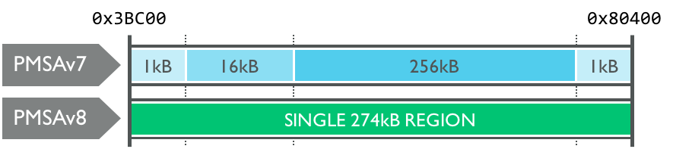
What’s new in MPUS (PMSAv8)?
More MPU regions (up to 16 regions for both normal and secure world in M23 and M33)
Use Start and Limit (end) address via separated MPU registers to define any size of memory regions, but still must be 32-byte aligned
PMSAv8 also introduces a new memory attribute indirection register (MPU_MAIR), making it easier for multiple regions to share the same attribute, while at the same time maintaining their own access permissions.
Notes:
In ARMv eight arch
The programming become a bit more flexible
The number of MPU regions has been increase to 16
And also use seprated start and limilit addres regs to define arbitrary address speace for a memory region
And also also introduces a new memory attribute indirection register to share same memory attributes with different memory with differen access permissions.

Slide 7
Agenda
Introduction to Memory Protection Unit (MPU)
MPU adoption in the wild
Common pitfalls and limitations in using MPU
Mitigation suggestions
Summary and disclosure
Notes:
So it seems MPU should be useful
Let look at how the real world OS use the MPU and what specific security functions can be provided by mpu

Slide 8
MPU-enabled common security functions
Code Integrity Protection (CIP): Code regions can be set as non-writable to prevent code injection and manipulation.
Data Execution Prevention (DEP): Data regions like stack or heap can be set non-executable
Stack Guard (SG): A redzone can be placed at the task stack boundary to detect stack overflows.
Kernel Memory Isolation (KMI): User mode (unprivileged) code cannot access any memory belonging to the kernel space without invoking system calls
User Task Memory Isolation (TMI): User mode (unprivileged) tasks can only access its own memory except explicitly shared memory regions that belong to other tasks or kernel.
Peripherals Isolation (PI): Peripheral access is restricted to tasks having the privilege to access it.
Notes:
First Os can assign the code regions as non-writeable to achieve code integrity
And non executiable for data region for DEP
also can be used achive stack guard with a same inaccessible memory region after the stack boundady
Most importandly, the RTOS can take advantaged of Mpu to achieve the user and kernel space speration
We will detail this later with a concrete example.

Slide 9
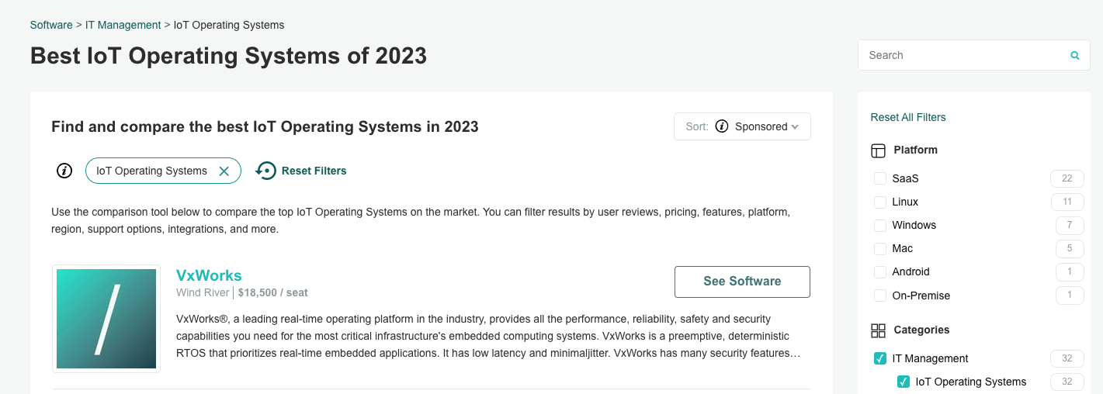

MPU adoption in the wild
We did first comprehensive study on MPU usage of top 30 IoT operating systems according to market rating.
Notes:
Let’s us first see whether security feature has been adopted in wild
As we reviewed popular RTOS code and documents
To our surprise, so shown in the table Only a few MCU OSs use MPU, especially for the open-source
Even if MPU is supported, only a few security features are enabled by default
So in this work we are trying to find why MPU has been outcast in RTOS

Slide 10
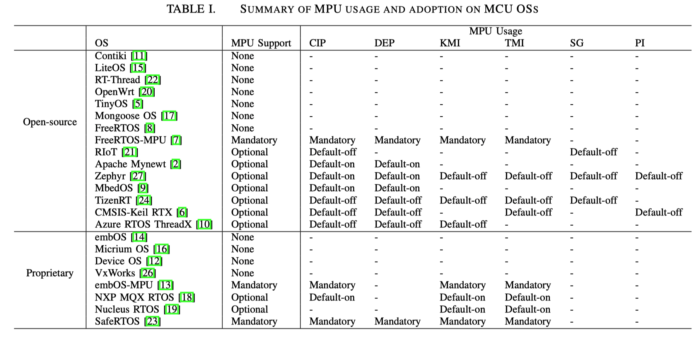
Observation
We try to find out the reasons in this work.
Only a few MCU OSs use MPU, especially for the open-source OSs
Even if MPU is supported, only a few security features are enabled by default

Slide 11
Research Question
Why haven't MPUs been widely used in IoT operating systems?
Why do only a few OSs enable full-blown MPU-enable protection by default?
How do the OSs implement MPU-enable protections in detail?
Are MPU-enable protections effective?

Slide 12


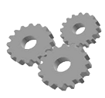

Case Study : MPU-enabled RIoT
RIoT runs all the code under privileged level, thus it can only provide some basic protections such as DEP, and stack guard (SG) with MPU
MPU
MEMORY
Peripheral N
Data Execution Prevention (DEP): RIoT enables the MPU region number 0 to cover the whole RAM region as non-executable
Stack Guard (SG): RIoT sets last 32 bytes (the smallest MPU region) on the main stack as read-only via the MPU region number 1. Similarly, when switching to another task, RIoT configures the last 32 bytes of the target task stack as read-only.
Stack for
task A
ARM
#0
#1
Cortex-M
Stack for
task B
Task A
#1
privileged
stack for
OS kernel&IRQ handler
Task B
privileged
#1
OS kernel
(privileged)
code for
OS kernel
code for
Tasks
Notes:
First for the OS does not used MPU for kernel and task privileged separation run all code under privilege level, so only some basic mpu security features they can adoptes
For example Riot sets whole ram regions as non-executable to achieve dep
And it define a minimal MPU regions at the end of kernel stack to defined stack overflow
and also at the boundary of each running task stack
And it cannot detect the stack overfolow of indivifual function stack frame and ROP attack

Slide 13
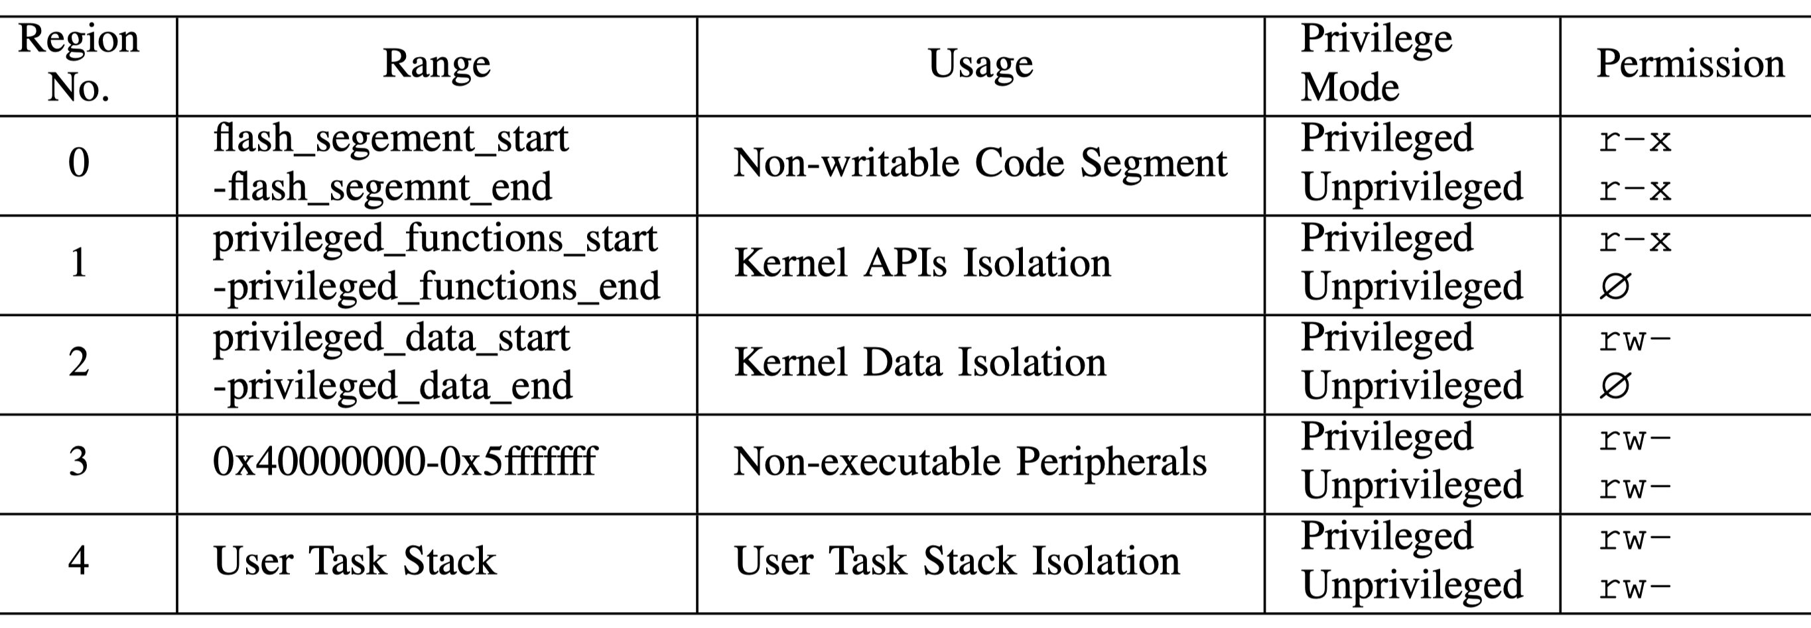
Case Study : FreeRTOS-MPU
MEMORY
Peripheral N
Peripheral C
#3
Peripheral B
Peripheral A
Stack for
task A
#4
Stack for
task B
#4
data for
OS kernel
#2
code for
OS kernel
#1
Background region in grey is enabled for privileged access only
code for
system calls
#0
code for
Tasks
Notes:
FreeRTOS-Mpu use 5 regions by default as shown in the table to achieve code interuoty DEP and kernel task islation

Slide 14
Case Study : FreeRTOS-MPU
MPU
MEMORY
Code Integrity Protection (CIP): All code regions including tasks, system calls and kernel cannot be written.
Data Execution Prevention (DEP): All data regions including tasks, kernel, and peripheral regions are non-executable
Peripheral N
#3
Peripheral C
Peripheral B
Peripheral A
ARM
#4
Stack for
task A
Cortex-M
Task A
#4
Stack for
task B
unprivileged
Task B
#2
data for
OS kernel
OS kernel
(privileged)
unprivileged
#1
code for
OS kernel
code for
system calls
#0
code for
Tasks
Notes:
Specifically First it assigns region 0 as non writeable to achieve CIP and the data region of kenerl task and peripherals as non-executatble

Slide 15
Case Study : FreeRTOS-MPU
MPU
MEMORY
User Task Memory Isolation (TMI): Unprivileged tasks can only access their own stack and up to three user definable memory regions (three per task)
Peripheral N
#3
Peripheral C
Peripheral B
Peripheral A
ARM
Kernel Memory Isolation (KMI): The FreeRTOS kernel API and data are located in a region of Flash that can only be accessed while the microcontroller is in privileged mode (calling a system call causes a temporary switch to privileged mode)
#4
Stack for
task A
Cortex-M
Task A
Stack for
task B
unprivileged
Task B
#2
data for
OS kernel
OS kernel
(privileged)
unprivileged
#1
code for
OS kernel
code for
system calls
#0
code for
Tasks
Notes:
And use a memory region to restrict the unprivileged task code can only read write its own task
The data and code can only be accessed by kernel which is running under privilege level

Slide 16
Case Study : Zephyr
Peripheral Isolation (PI): By default, a peripheral driver instance is considered as a kernel object. Therefore, its range is pre-conﬁgured to be inaccessible by user tasks. To access peripherals, a user task must invoke system calls.
k_oops()
N
User
mode
Valid
Call ID
Lookup
marshaller in
dispatch table
API Call
Y
Marshal args,
Trigger SW IRQ
Y
N
Return to
Caller
Implementation
Marshal Return,
Value,exit IRQ
Implementation
P
Verify
F
return error
code
Zephyr System Call Procedure

Slide 17
Case Study: Keil RTX CMSIS-Zone
TMI: Based to user configuration, CMSIS-Zone assigns the access permission (RWX) to a bundle of memory regions and peripherals as an isolated execution zone.
However, Keil RTX does not offer isolation between normal user tasks and the kernel (i.e., KMI is unsupported), so code and data of the kernel cannot be entirely hidden to user tasks.
Shared Code
Task A
Code A, Data A, Peripheral A
Task B
(Code B, Data B, Peripheral B)
Task C
(Code C, Data C, Peripheral C)
Each box is a protected execution zone

Slide 18
Agenda
Introduction to Memory Protection Unit (MPU)
MPU adoption in the wild
Common pitfalls and limitations in using MPU
Mitigation suggestions
Summary and disclosure
Notes:
OK next
I will shed light on the root cause of this situation

Slide 19
Common pitfalls in using MPU
Weak protection
Case study: Bypassing MPU protection in RIoT-MPU
Case study: Privileged escalation in FreeRTOS-MPU
Incomplete protection
Prohibitive overhead
Conflict with existing system designs
Fragmented programming Interface
Notes:
We summay the common pitfalls as four aspect
First we show how to disable or easily bypass the protection provide MPU with real world examples

Slide 20
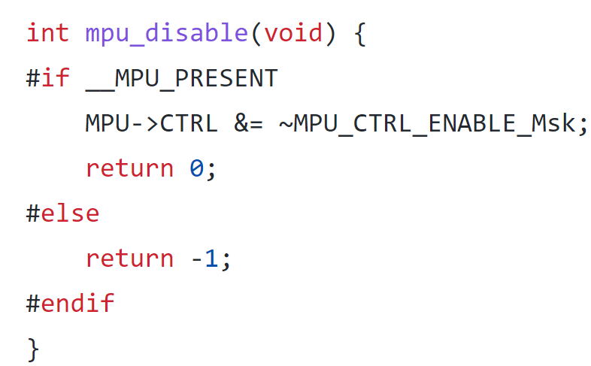
Bypassing MPU in MPU-enabled RIoT
Bug: MPU can be disabled by control flow hijacking attack (e.g., ROP)
Cause: MPU control registers (e.g., MPU_CTRL) are located in the system peripheral region, which can be accessed by any privileged code. RIoT also provides an easy-to-use driver APIs for MPU configurations (e.g., mpu_enable and mpu_disable driver APIs).
MEMORY
MPU
Peripheral N
Stack for
task A
#0
ARM
#1
Cortex-M
Stack for
task B
Task A
#1
privileged
stack for
OS kernel&IRQ handler
Task B
privileged
#1
OS kernel
(privileged)
code for
OS kernel
code for
Tasks
Notes:
Since the MPU regs can be configured by privileged code
And RioT also have some easy to use driver apis for MPU configurations like mpu disable
So if any buffer could be overflow in the firmware, the attacker can use it to call mpu disable function in kernel and shutdown all mpu funcitnos

Slide 21
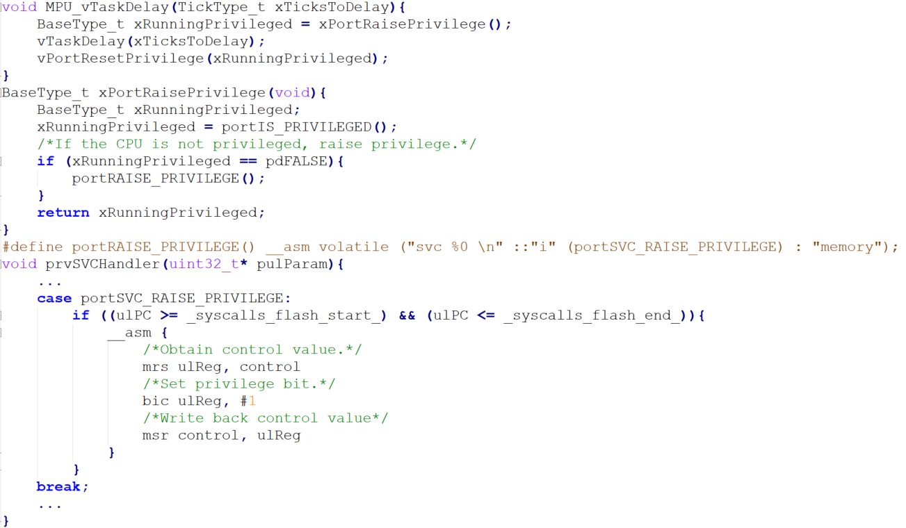
System call in FreeRTOS-MPU
For compatibility, FreeRTOS MPU does not provide new kernel APIs for system calls, but wraps the original kernel APIs with the xPortRaisePrivilege and vPortResetPrivilege to raise/drop privileges
MPU
MEMORY
Peripheral N
#3
Peripheral C
Peripheral B
ARM
Peripheral A
#4
Stack for
task A
Cortex-M
Task A
Stack for
task B
unprivileged
Privileged
Task B
#2
data for
OS kernel
OS kernel
(privileged)
unprivileged
#1
code for
OS kernel
code for
system calls
#0
code for
Tasks
Notes:
So if unprivileged task wants to use kernel function it can only go thorugth system calls
FreeRTOS mpu version does not provide new kernel apis for system calls but just wrap original kernel with privilege switch function via SVC hanlder
SO for example if unprivlieige task want to use keneral function MPU delay if will call mpu wrapper function to raise privileged than call the kernel function
When function completed Resetprivliegd function will be called to drop privileged

Slide 22
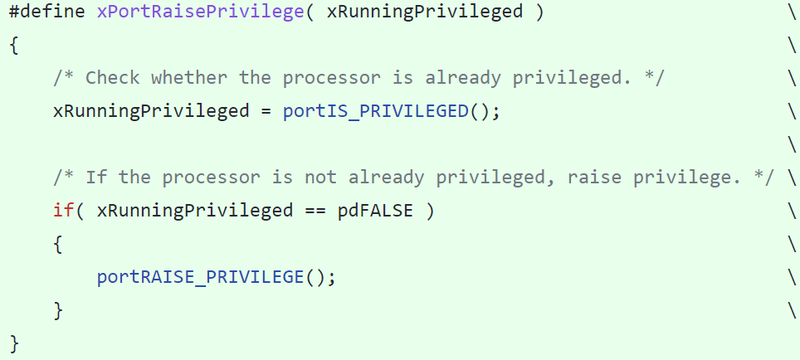
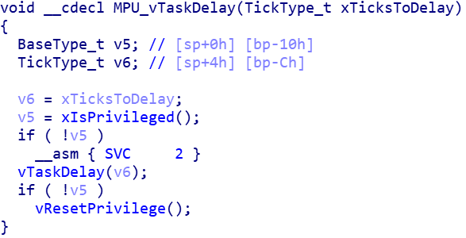
Privilege escalation in FreeRTOS-MPU
Bug1 (v10.4.5 and before): An unprivileged task can raise its privilege by calling the internal function xPortRaisePrivilege
Cause: Privilege escalation function (xPortRaisePrivilege) is a kernel function which can be called directly
MPU
MEMORY
Peripheral N
#3
Peripheral C
Peripheral B
Patch (v10.4.6): Change it to macro implementation
Peripheral A
ARM
#4
Stack for
task A
Cortex-M
Is problem solved?
Task A
Stack for
task B
Privileged
unprivileged
Task B
#2
data for
OS kernel
OS kernel
(privileged)
unprivileged
#1
code for
OS kernel
code for
system calls
#0
code for
Tasks
Notes:
So we easily find the MPU privilege Switch function are exposed to the unprivliege task
Unprivlieg task can directly call the xportrasie privlielig function to rasie the function
To fix this issue freeRTOS has change the function as a maro （mai ke rou）
However is that really solve the problem?

Slide 23
Privilege escalation in FreeRTOS-MPU
Bug2 (v10.4.6 and before): Privilege escalation by branching directly inside system calls (MPU wrapper APIs) with a manually crafted stack frame
MPU
MEMORY
Peripheral N
#3
Peripheral C
Causes: Privilege escalation operation (SVC interrupt) is separated with kernel API and uses stack to store the original privilege level
Peripheral B
Stack for
task B
Peripheral A
ARM
#4
Stack for
task A
Cortex-M
unprivileged
Privileged
Stack for
task B
task
A
unprivileged
#2
data for
OS kernel
task
B
①
OS kernel
(privileged)
#1
code for
OS kernel
②
③
④
code for
system calls
⑤
#0
⑥
code for
Tasks
Notes:
Let’s us look deeper in the wrapper function
We found the wrapper function will first to store the origital caller privilege level in the stack
It unprivliege caller it will first to use svc to rasie prievliege and then call kernel function
And writhdraw preivlieg level on stack and to check whether caller is uprivlieged
If does it will reset prilviegdel
===开始动画
However if Unprivilege task has been compromised it can directly call the svc 2 instruction in the system call then attacker can further manpulited the privilege level in unprivileged stack so when kernel function finished it will not drop back the privileged level

Slide 24
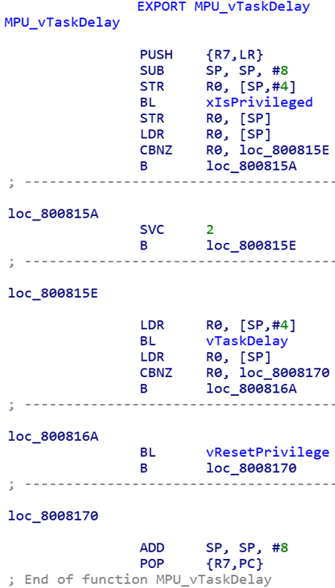
Exploitation Steps
0x2000XXX+N
0x2000XXX+N
…
…
Buffer
Overflow
Stack
growth
Address to SVC 2
LR(Return Address)
Padding
Stack Frame
（A function in unprivileged task)
vars
Stack Frame
（A function in unprivileged task)
Buffer
（unprivileged）
Buffer
（unprivileged）
0x2000XXX
0x2000XXX
Privilege Level Manipulation
0x2000XXX+N
…
Stack Frame
(MPU wrapper function)
Privileged Level
①
SP
Address to SVC 2
②
Padding
Stack Frame
（A function in unprivileged task)
③
④
⑤
Buffer
（unprivileged）
⑥
0x2000XXX
Notes:
Let me further detail the explitaiton step with a sample overflow buffer on the unpdialite task
First attack overflow the buffer and replace the function return address as svc 2 instrction in any system call for example here in mpu task delay
Then when funcinton returen it will jump to the svc 2 insturion and then call the kernel function
After that it will read the origal privilege level from the stack
However here we further manipulate the stack data to fake the privilege level on the stack.
So when firmware withdraw privilege level on stack
It will mistake the orginall caller is privliegd

Slide 25
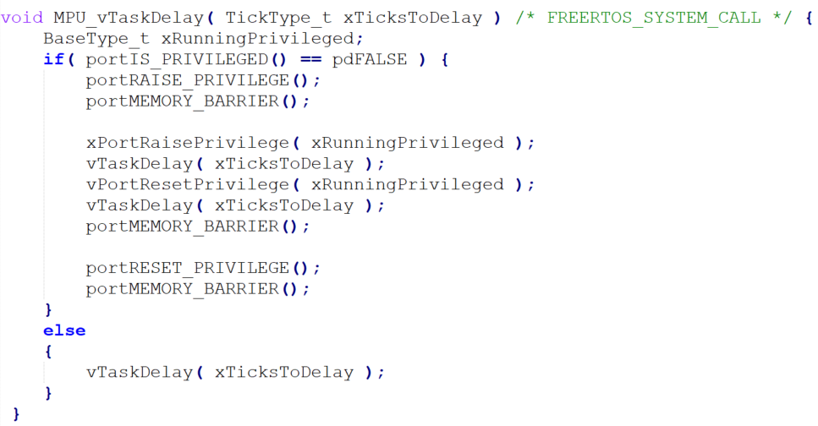
Patch
Decide the original privilege level at the beginning using control register
Introduced the portMEMORY_BARRIER macro to prevent instruction re-ordering when GCC link time optimization is used
Notes:
The freertos further fixed this issue
It change the prilivge level at the beifgioning of the system call
So even if attacke jump into raspriliveg the system will force it restrrprielige

Slide 26
Common pitfalls in using MPU
Weak protection
Case study: Bypassing MPU protection in RIoT-MPU
Case study: Privileged escalation in FreeRTOS-MPU
Incomplete protection
Prohibitive overhead
Conflict with existing system designs
Fragmented Programming Interface
Notes:
No we dicuss other pitfalls of Mpu

Slide 27
Incomplete protection
Unsafe interrupt handlers
Exception vector reads from the Vector Address Table always use the default system address map and are not subject to an MPU check
Interrupt handlers (handle mode) run in the privileged mode, which can access any resources
Incomplete protection for peripherals
Any load, store or instruction fetch transactions to the PPB, within the range 0xE0000000-0xE00FFFFF (system peripherals), are not subject to an MPU check.
Due to the programming constrains (e.g., 32B granules and alignment requirement), MPU is not suitable for protecting peripherals with small regions
Notes:
We further found even if the implentatlieion of MPU addition has no vunlnerialiie
The protection provided by MPU is limited
For example it cannot protection the interrupt hanlders since all interrupt vetor address table cannot be monitor by MPU and interrupt alwareys run in hanlder mode under privilege level the developer cannot assign specific handlers for the unprvileige task
So due to region consitatiosn MPU is not suitable for protecting peripherals with small regions

Slide 28
Incomplete protection
Incomplete permissions assignment
No execute-only (XO) permission
Privileged permission ≥ Unprivileged permissions
Arm MPU does not restrict peripherals as master, allowing them to access all memory (e.g., via DMA)
Notes:
Also the advanced protection as NO executto only protecitnon can not achieve by MPU and prireim permission always beyoethe unprivlielge
So it can not protecting the securioty appriton when os has been comprioatinsed

Slide 29
Prohibitive overhead
To leverage MPU to realize kernel/task isolation, invocation to kernel APIs has to go through context switch twice
Our experiment shows that one thousand privilege switches in a FreeRTOS-MPU system takes 3.5ms on average on the MPS2+ FPGA prototyping system broad (Cortex-M4 AN386) with 25MHZ CPU clock frequency.
MPU regions need to be re-configured for different tasks and applications.
FreeRTOS has to reset MPU regions #5-7 during an application switch
Tizen has to reset MPU regions #3-7 during an app (including multiple tasks) switch and #6 and #7 during a task switch
Notes:
So To leverage MPU to realize kernel/task isolation, invocation to kernel APIs has to go through context switch twice
That will incurs too much delay when task needs many kenral funcitons considering many IoT application has deadline contstration
Such overhead cannot be iginore and also the MPU regions for speiliack task needed to be updated during task swtih will also incur the time delay

Slide 30
Conflict with exiting system design
Limited MPU regions for real world applications
Very few available user-defined regions for peripheral isolation
No OS provides peripheral isolation by default.
Very few available regions shared between two tasks
No OS provides shared memory protection by default.
It is impossible to enable too many security features at same times
E.g., activating all MPU features in Tizen exhausts all MPU regions
Porting software leveraging MPU may cause compatibility issues
Only 30% manufacturers implement MCU hardware security features in current designs
Notes:
Also we found the memory regions number constrains is the main proble for real world rtos application
For example Very few available user-defined regions for peripheral isolation it will consurme many regions for different peripeero protections
So we found No OS provides shared memory protection by default.
Interestliy we also found that is to enable too many security features at same times with MPU
For example
When activating all MPU features provided by Tizen, there is no more available MPU regions on ARM Cortex-M0+/M3/M4 based MCUs which only support eight MPU regions
Porting software leveraging MPU may cause compatibility issues we have witness many of them on developer form

Slide 31
Fragmented Programming Interface
Chip vendors may design customized MPUs, which provide better security guarantees, but impose a steep learning curve for developers
This may discourage them from adopting MPUs or even lead to programming errors
Case study: NXP‘s Kinetis series MCUs discard ARM MPU and integrate NXP’s proprietary system MPU (i.e., sysMPU)
It can restrict the permission of peripherals as masters
When enabled, by default, peripherals cannot access RAM
To use it, developers have to properly configure sysMPU. Otherwise, many official demos cannot execute

Slide 32
Agenda
Introduction to Memory Protection Unit (MPU)
MPU adoption in the wild
Common pitfalls and limitations in using MPU
Mitigation suggestions
Summary and disclosure
Notes:
So at last we will also give some suggestion to miniali pitfalls

Slide 33
Minimizing pitfalls
Be careful about permission overlap
Observation: all open-source OSs but the latest FreeRTOSv10.5 use lower-number MPU regions for kernel protections ().
Risk: Developer could configure those higher numbered user-defined MPU regions to override kernel protections.
Recommendation: System and general protection (e.g., KMI, DEP,CIP) should use higher-number MPU regions.
Notes:
First to Be careful about permission overlap
Since the ARM allows MPU regions to overlap, and higher-numbered regions always have precedence.
So we recommend the System and general protection (e.g., KMI, DEP,CIP) should use higher-number MPU regions and let user-defined mpu regions as lower number ones

Slide 34
Minimizing pitfalls
Be careful about privilege switch during system calls
Observation: OSs wrap the kernel APIs by temperately raising and dropping privilege (e.g., FreeRTOSv10.5.0 before).
Risk: Privilege escalation with control flow hijacking or a manipulable stack.
Recommendation: MCU OSs should provide a system call interface with software interrupts, similar to traditional OSs. Alternatively, they can enforce additional caller checks before system call invocations, and the kernel should make sure that the privilege is dropped after system calls.
Notes:
Second as I demonstrated before be careful about any privilege escalation enties expiaoint for the system call
Ideally we recommend MCU OS should use individual system calls for kernels API with software interrupts moder os does

Slide 35
Minimizing pitfalls
Avoid over-privileged execution
Observation: OSs which only provide protections like Stack Guard, DEP and CIP, always run the whole system at the privileged level like RIoT.
Risk: Disabling the desired protections by reconfiguring MPUs with control flow hijacking attack.
Recommendation: System drop privilege whenever possible.
Notes:
Even some rtos does not use preivliege serpeation for kernel and task and only enable the genrela protenciton like RiOT
However, in casue the attacker to bypass mPU configiroatn we recommend System should drop privilege immediately after MPU configuration.

Slide 36
Region usage optimization
Leverage the default MPU region on ARMv7-M
Default memory access permissions/attributes of memory regions is enforced by ARM without MPU
E.g., non-executable for standard and system peripheral regions
Leverage sub-regions
Save memory usage.
Without Sub-region
With Sub-region
MEMORY
(ARMv7-m)
MEMORY
(ARMv7-m)
8KB memory used with one region
Running Task B
8KB MPU region
Task B Stack
5KB
Task B Stack
5KB
Running Task B
SRD = 11111000
12KB memory used
Task A Stack
3KB
Running Task A
SRD = 00000111
Running Task A
4KB MPU region
Task A Stack
3KB
Notes:
As we mentioned above the number of region is very limited
So we also give some suggestion to mini the region numbers and make better use of MPU
First Be aware of the default ARMv7-M address map permissions.
ARM and other cpu often define the Default memory access permissions/attributes which are direcely enforce by cpu
For example peripheral region is non-executeable by default so it no need to waste another MPUregion to assign non executeable for perielas
And we found none of RTOS use sub region features
For example if there are two tasks
Task A needs 5 KB for its stack and task B need 3 KB so without sub region due to aligment contrains power of two in ARM v seven arch OS will assign 8 kB for task B 4Kb so there will be 12 Kb memory cosueme if we take addvanat of sub regions we can assign one MPU region with eight Kb and enable lower 3KB for task A when it running and enable higher 5Kb for task B when it running so in tatoa only 8Kb mrmeoyr needed

Slide 37
Region Usage Optimization
Leverage sub-regions
Save memory usage
Save MPU regions
Without Sub-region
With Sub-region
MEMORY
MEMORY
SRD
Peripheral H
Peripheral H
1
0
1
0
1
1
1
0
Peripheral G
Peripheral G
At least three separated
MPU Region needed
Peripheral F
Peripheral F
Peripheral E
Peripheral E
Only one MPU Region
Peripheral D
Peripheral D
Peripheral A
Unprivileged
Peripheral C
Peripheral C
Peripheral C
Privileged
Peripheral B
Peripheral B
Privileged
(background region)
Peripheral A
Peripheral A
Notes:
Also sub regions is sutitable for peripehal regions protection
Since the space the mmio is usually the same for example there are eight peripheral in a continuous mmio space
If we want to assign peripher GEA can only be assigned by perioelal, we have to use at leeat three speprate mpu regions
However with help of sub resgoin we only need to assign one memory regions as unprvileligee access with whole range
Then we can disable the subregion of peripheral G E and A. So the disable sub-region will go with same backgorud region which is priligeed access only just satitliy our exexpted

Slide 38
Region Usage Optimization
Automatically find optimized region allocation strategies
MINION (NDSS 2018)
ACES (USENIX Security 2018)
Notes:
At least
As supplement we can also learn some novel usage for academic community
The unimtate goal we use the MPU is to ensuring code can only acces its requiret data so it acutly not need to be folloing the user space and kenel space speration
For example some research proposed to isolates tasks with memory view switches (task and kernel are all running on unprivileged level) to reduce the overover incurred by privilege escalation
isolates compartments based on code functionality
We also can taking more advance hardware feture to achieve more system protection like secure regiosn of trstuzone and also truslistate redesign that MPU

Slide 39
New Hardware Security Features
ARMv8-M architecture extends the TrustZone technology to Cortex-M series. The secure regions can be used as additional regions and be assigned with higher privileged level beyond privileged level in normal world.
Trustlite proposed execution-aware MPU which the not only validates data accesses (read/write/execute) but additionally considers the currently active instruction pointer as the subject performing the access.

Slide 40
Agenda
Introduction to Memory Protection Unit (MPU)
MPU adoption in the wild
Common pitfalls and limitations in using MPU
Mitigation suggestions
Summary and disclosure

Slide 41
Summary
To our surprise, we found that MPU as a ready-to-use security feature for protecting microcontroller is rarely used in real-world products
We studied the source code of multiple MCU OSs to find explanations for this situation and eventually identified some common pitfalls.
Some of the flaws are fundamental and not remedial in a short term
We give recommendations for better use of MPU

Slide 42
Disclosure
All bugs we demonstrated has been patched in latest FreeRTOS kernel
Security update Reference: https://www.freertos.org/security/security_updates.html
RIoT developer team has acknowledged our finding, but the benefit of disabling access to the MPU or the `mpu_disable()` function without a userspace / kernelspace split is quite limited, only mildly increases the attack surface in the context of the attack model RIOT assumes.

Slide 43
Q&A

